Slide 1
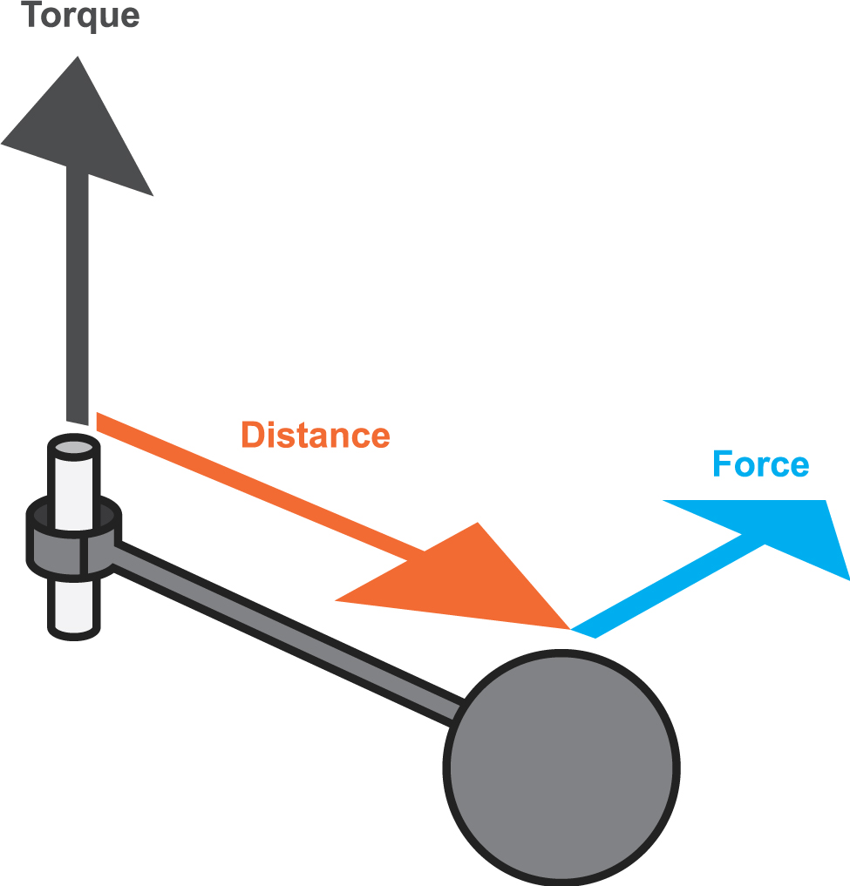
TORQUE
A Turning Effect

Slide 2
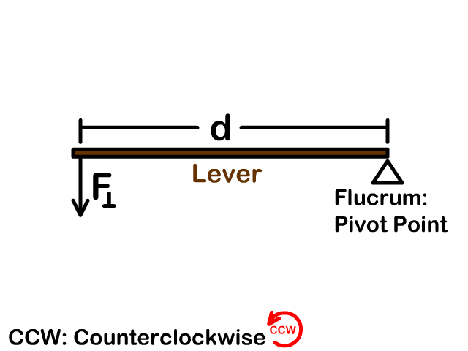
TORQUE
Torque, sometimes called “moment of a force”, or simply, “moment”, is best described as a turning effect. It occurs when an object turns about a pivot point (sometimes called the “axis of rotation” or “fulcrum”).
Fulcrum

Slide 3
TORQUE
The force is applied at a distance from the pivot point; the arm separating the pivot point and the application of force is called the “lever arm”.
Fulcrum
Notes:
“Line of action” notation is confusing – should refer to the line/direction along which the force is acting.

Slide 4
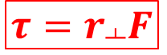

TORQUE
The size of the torque is given by the equation:
This equation is sometimes written as follows:
The torque is a product of ‘r’ (the perpendicular distance from the force to the pivot point) and ‘F’ (the applied force).
$$τ=r×F$$
$$τ=r_{┴}F$$

Slide 5
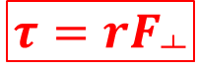
TORQUE
We can also write it as follows:
The torque is a product of ‘r’ (the distance from the force to the pivot point) and ‘F’ (the perpendicular component of the applied force).
These slight differences in definition may seem trivial, however understanding them can be useful for problem solving. Essentially, torque is generated if ‘r’ & ‘F’ are perpendicular; torque is 0 when they’re parallel.
$$τ={rF}_{┴}$$

Slide 6
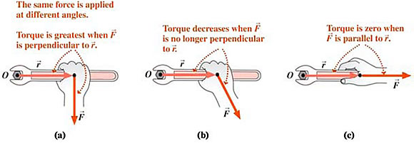
Since torque is the product of force (N) and distance (m), the units for torque are Newton-meters (N m).
Notes:
Not nanometres, and not Newtons per meter!

Slide 7
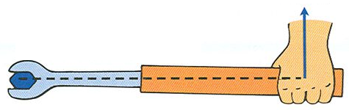

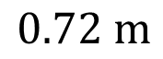
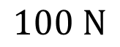
A SIMPLE TORQUE PROBLEM
Let’s find the torque on the wrench:
$$τ=r×F$$
$$100 N$$
$$0.72 m$$
$$τ=r×F=\left(0.72\right)\left(100\right)=72 N m$$

Slide 8
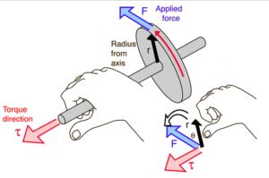
ANOTHER SIMPLE TORQUE PROBLEM
The radius is 0.50 m and the force is 500 N:
$$τ=r×F$$
$$τ=r×F=\left(0.50\right)\left(500\right)=250 N m$$

Slide 9
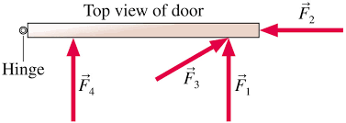

EVERYDAY APPLICATIONS
From the equation, we can see that the torque effect is proportional to both the applied force and the distance from the pivot point.
Think about the following situations – which is the correct way to do them and why? First, which is the best way to open a door?
$$τ=r×F$$
Notes:
F1 – greatest ‘r’ value, perpendicular to line of action.

Slide 10
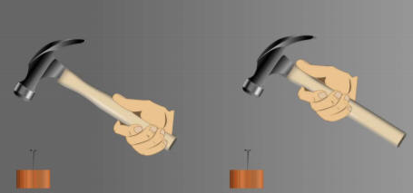
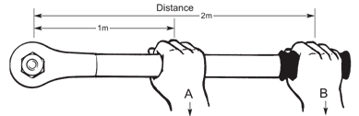
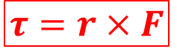
EVERYDAY APPLICATIONS
$$τ=r×F$$
Which is the best way to hold a hammer?
Which is the best place to hold a wrench?
Notes:
Hammer – left (greater distance from pivot point, either wrist or ball-joint of arm). Wrench – B (greater ‘r’ value).

Slide 11


EVERYDAY APPLICATIONS
$$τ=r×F$$
Which is the best steering wheel for a bus or truck?
Notes:
Bigger wheel – larger ‘r’ value from centre to wheel (where hands apply force), therefore more torque generated to turn larger vehicle. Less of an issue now with the advent of power steering.

Slide 12
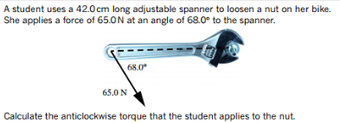

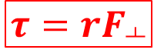
USING THE DIFFERENT DEFINITIONS
Let’s have a look at a problem (from your books – p.104 onward).
There are two ways to solve this, using our two ‘different’ equations. Let’s have a look.
$$τ=r_{┴}F$$
$$τ={rF}_{┴}$$

Slide 13
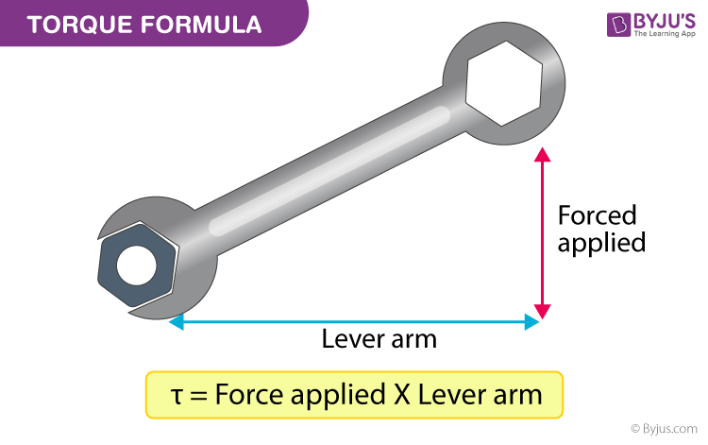
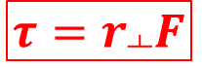



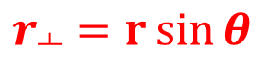
USING THE DIFFERENT DEFINITIONS
Find the perpendicular distance to the pivot point.
Our equation becomes…
Substitute our values and solve:
$$r$$
$$r_{┴}=r\sin{θ}$$
$$=0.42\sin{68°}$$
$$τ=r_{┴}F$$
$$τ=rF\sin{θ}$$
$$τ=65×0.42\sin{68°}=25.3 N m$$

Slide 14

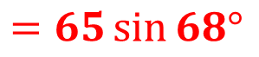

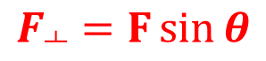
USING THE DIFFERENT DEFINITIONS
Now, let’s try to solve the same question another way.
$$F=$$
$$F_{┴}=F\sin{θ}$$
$$=65\sin{68°}$$
Find the perpendicular component of the force.
Our equation becomes…
Substitute our values and solve:
$$τ={rF}_{┴}$$
$$τ=rF\sin{θ}$$
This is the same as last time!
$$τ=0.42×65\sin{68°}=25.3 N m$$

Slide 15
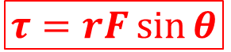
TORQUE
So, our best equation for torque is…
θ is the angle between ‘F’ & ‘r’.
As θ goes to 0˚, (r parallel to F), sin θ goes to 0, and so does τ.
As θ goes to 90˚, (r perpendicular to F), sin θ goes to 1, and τ becomes a maximum (and can just be written as τ = rF).
$$τ=rF\sin{θ}$$

Slide 16
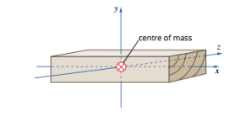
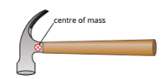
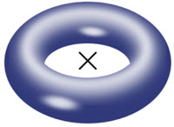
CENTRE OF MASS
As we discovered during our studies of gravitation, the mass of an object can be considered to be ‘concentrated’ at the centre of mass. For regular, uniform objects, where the mass is uniformly distributed, the centre of mass is usually the centre of the object. However, it doesn’t have to be. In fact, it doesn’t even have to be inside the object.

Slide 17
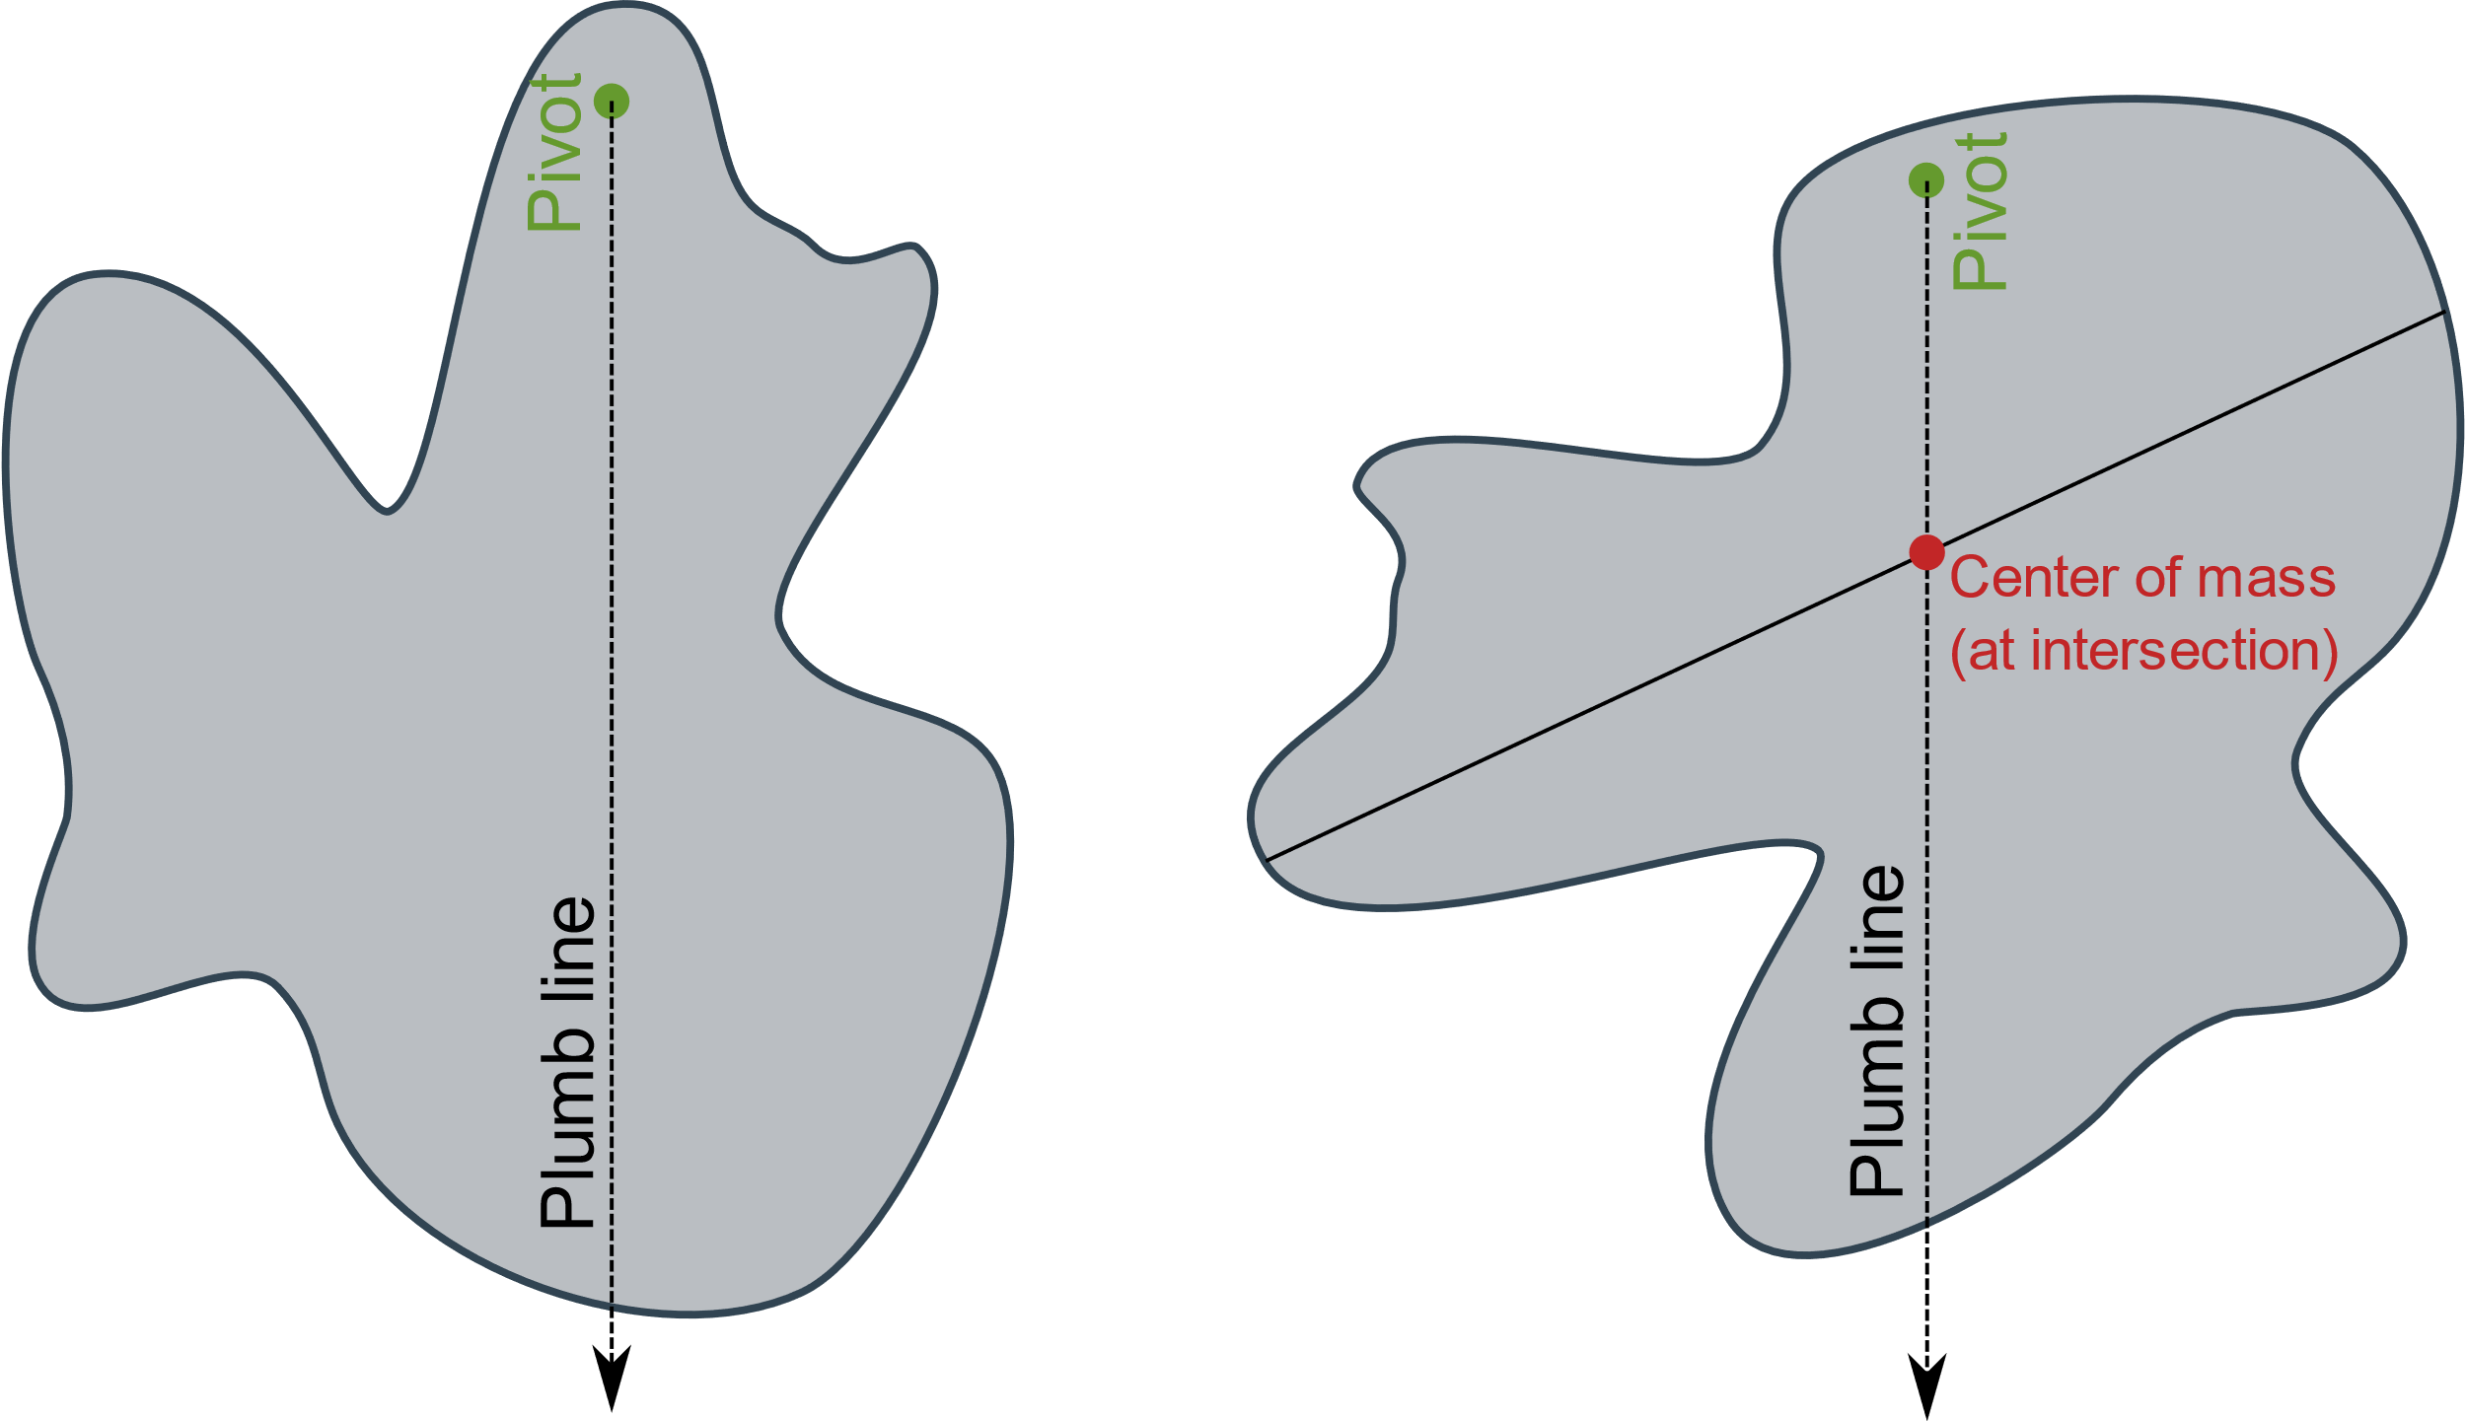

FINDING CENTRE OF MASS

Slide 18
STABILITY
Objects are stable (i.e. unlikely to tip) provided their centre of mass is over their base.
This means that an object is more stable if it has:
Lower Centre of Mass
Wider Base
This is because these objects need to tip far more to become unstable.

Slide 19
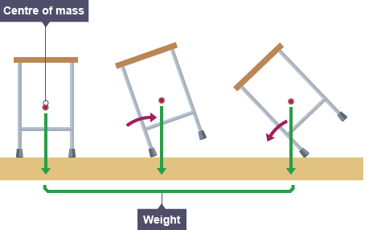
STABILITY
Once the centre of mass has passed the base, a torque is generated causing it to topple.
P
P

Slide 20
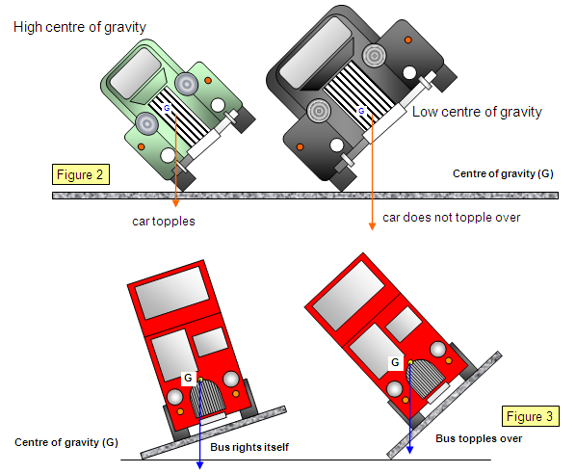
STABILITY

Slide 21
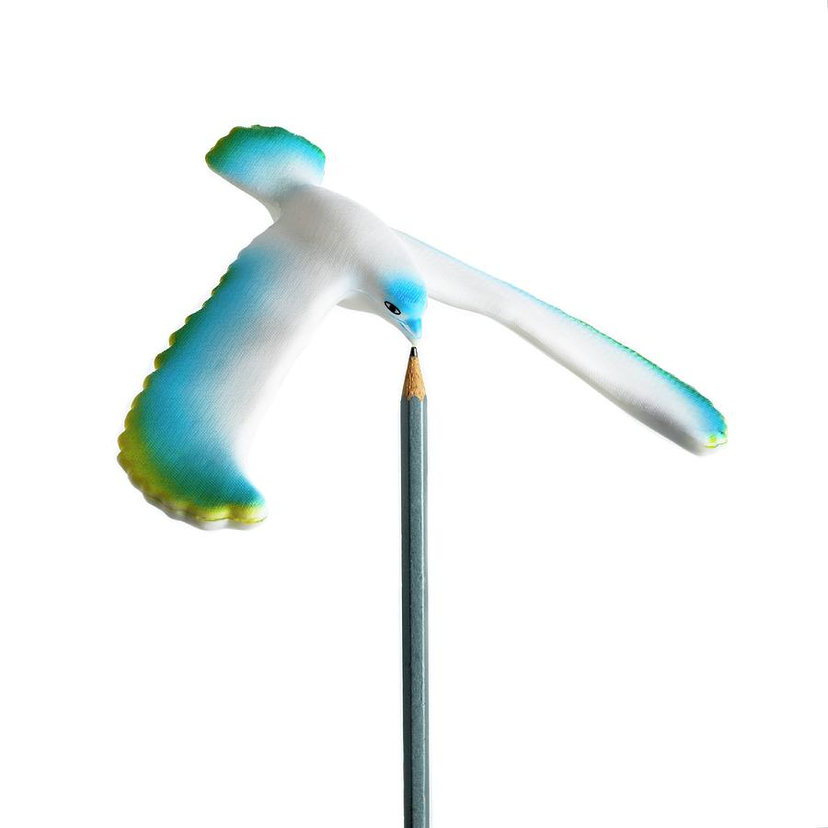
STABILITY
Notes:
COM is at the beak, so is very easy to balance there.

Slide 22

CENTRE OF MASS
People have a centre of mass too… as do other animals.
Notes:
Women & children tend to have better balance due to lower COM. Four-legged creatures can run faster due to lower COM, but also wider base (4 legs vs. 2).

Slide 23
CENTRE OF MASS MANIPULATION
We can move our centre of mass by moving our arms and legs. This is how pole-vault champions break world records – they can only get enough energy to make their centre of mass get so high. By contorting their bodies in the right way, pole-vaulters can have their bodies pass over the bar while their centre of mass passes under the bar.

Slide 24
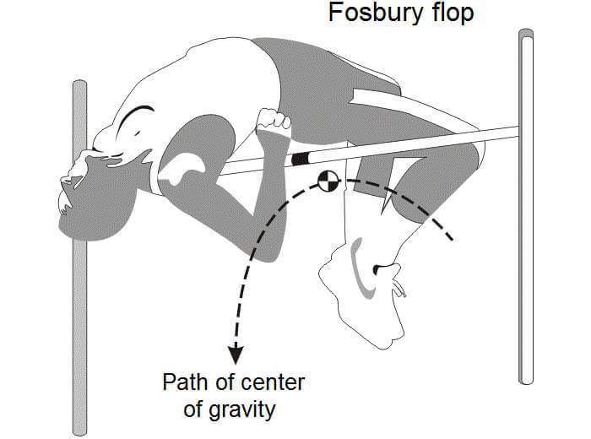
CENTRE OF MASS MANIPULATION
The technique is called the ‘Fosbury Flop’, after Dick Fosbury who introduced it in the 1968 Summer Olympics.

Slide 25
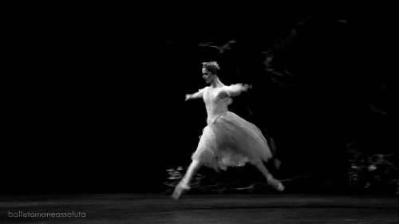
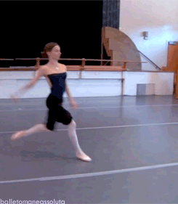
CENTRE OF MASS MANIPULATION
Ballet dancers can do a similar thing, giving them the appearance of ‘gliding through’ or ‘hanging in’ the air as they jump.

Slide 26
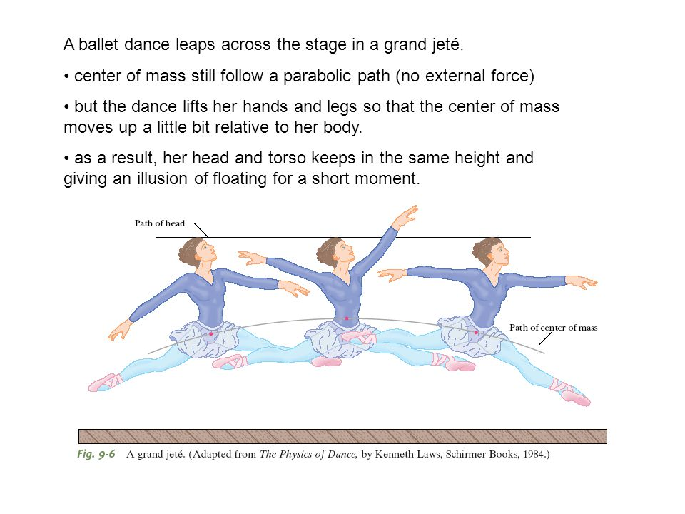
CENTRE OF MASS MANIPULATION

Slide 27
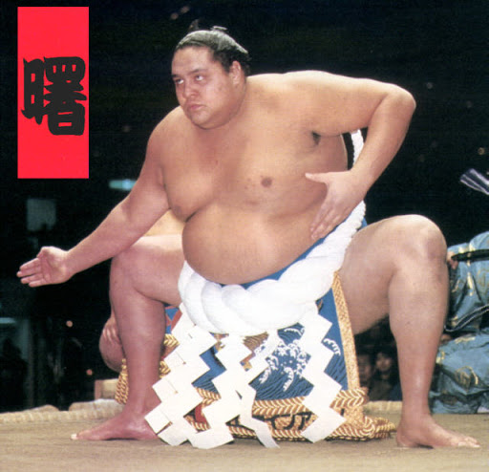
CENTRE OF MASS MANIPULATION
It also explains why sumo wrestlers adopt their stance as they do!
Low COM
Wide Base

Slide 28
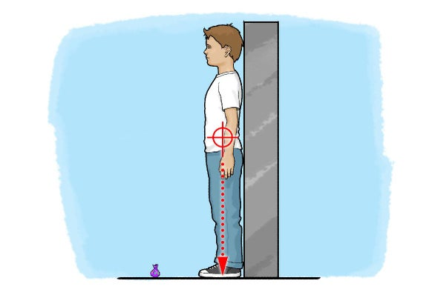
CENTRE OF MASS MANIPULATION
An experiment that you can do at home! Stand with your head, back, butt & feet squarely against the wall, then bend over at the waist (i.e. without bending your knees) and try to touch your toes. I bet you can’t!

Slide 29
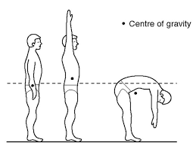

CENTRE OF MASS MANIPULATION
As you bend over, your COM begins to shift such that it is no longer over your base (i.e. your 2 feet). To ensure this doesn’t happen, when you bend over at the waist you have to push your butt out backwards. Unfortunately your butt is already against the wall and has nowhere to go – you push against the wall, the wall pushes back, you experience a torque… and you fall over!

Slide 30
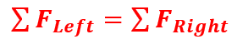
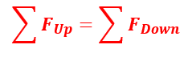


STATIC & ROTATIONAL EQUILIBRIUM
Remember this?
If an object is not accelerating, we can say that the forces up & down, left & right, must be balanced (static equilibrium).
Similarly, if an object is not rotating, then the torques must also be balanced (rotational equilibrium).
$$\sum{τ_{clockwise}}=\sum{τ_{anticlockwise}}$$
$$τ_{cw}=τ_{acw} or{ τ}_{ccw} (τ_{counter−clockwise})$$

Slide 31
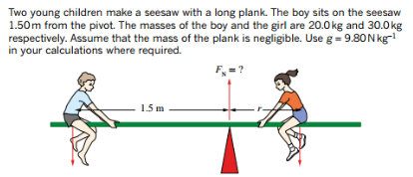
EXAMPLES (Pearson p. 119 - onwards)

Slide 32
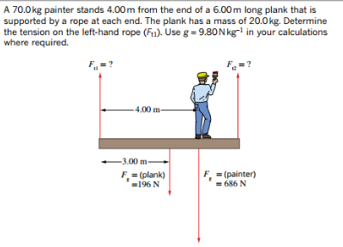
EXAMPLES (Pearson p. 119 - onwards)

Slide 33
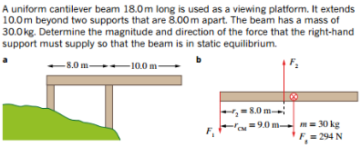
EXAMPLES (Pearson p. 119 - onwards)

Slide 34
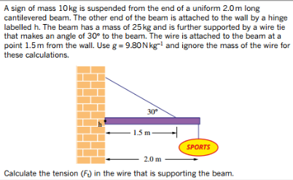
EXAMPLES (Pearson p. 119 - onwards)

Slide 35
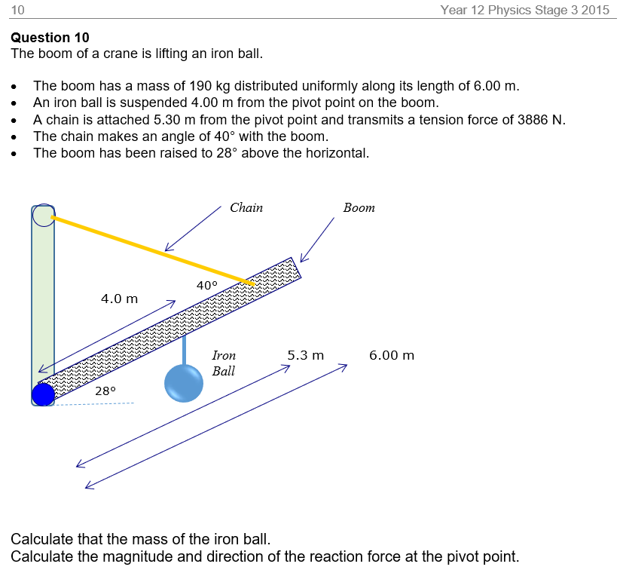
EXAMPLES (Past Exam)

